Slide 1




BANK LOAN ANALYTICS
GROUP 5:
M Senthil Kumar
R Prem Kumar
K Arulmozhi Deborah

Slide 2
AGENDA
Project Overview
Insights
Summary
Team Process

Slide 3
Project Overview
Background:
• Banks and financial institutions rely on loan approvals and repayments as a critical part of their business. However, managing risk is essential to ensure financial stability and minimize losses due to loan defaults.
• With the increasing availability of data, bank loan analytics plays a key role in improving decision-making, understanding customer behavior, and predicting loan performance.
Problem Statement:
• Banks face challenges in assessing loan applicants and predicting their ability to repay. There is a need for more accurate insights into loan approval patterns, customer risk factors, and reasons for loan defaults.

Slide 4
Team Process
Data Collection
Understanding the Data
Data Cleaning
& EDA
Analyzing the Data
Sharing Findings

Slide 5
Data Collection
id,member_id,loan_amnt,funded_amnt,funded_amnt_inv,term,int_rate,installment,grade,sub_grade,emp_title,emp_length,home_ownership,annual_inc,verification_status,issue_d,loan_status,pymnt_plan,desc,purpose,title,zip_code,addr_state,dti
FINANCE 1
DATASETS
FINANCE 2
id,delinq_2yrs,earliest_cr_line,inq_last_6mths,mths_since_last_delinq,mths_since_last_record,open_acc,pub_rec,revol_bal,revol_util,total_acc,initial_list_status,out_prncp,out_prncp_inv,total_pymnt,total_pymnt_inv,total_rec_prncp,total_rec_int,total_rec_late_fee,recoveries,collection_recovery_fee,last_pymnt_d,last_pymnt_amnt,next_pymnt_d,last_credit_pull_d

Slide 6
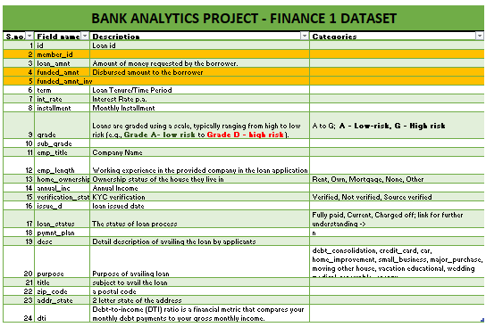
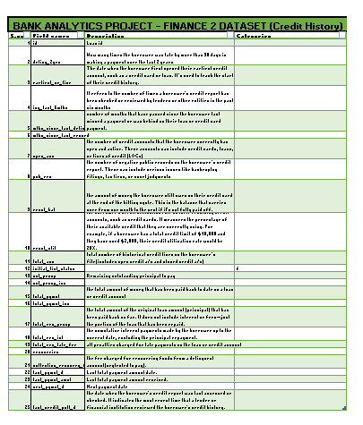
Data Understanding
To facilitate a better understanding of the data, we have created a metadata document for the bank analytics project.

Slide 7
Data cleaning & EDA
Tool Used: Excel Power Query, Power BI, Tableau, SQL
Steps Involved:
Removing Duplicates: Identified and eliminated duplicate records to ensure data accuracy.
Handling Missing Values: Addressed missing or incomplete data by either filling, removing, or imputing values.
Standardizing Data: Ensured consistency in data formats across all fields, such as date and currency.
Filtering Irrelevant Data: Removed unnecessary columns and rows that are not needed for analysis.
Data Transformation: Applied necessary transformations, such as splitting columns or creating calculated fields, to make the data analysis-ready.

Slide 8
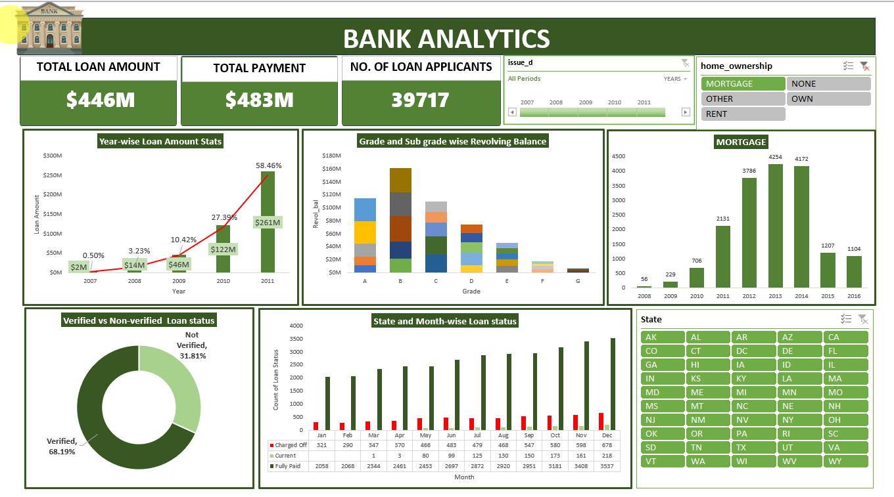
Excel Dashboard

Slide 9
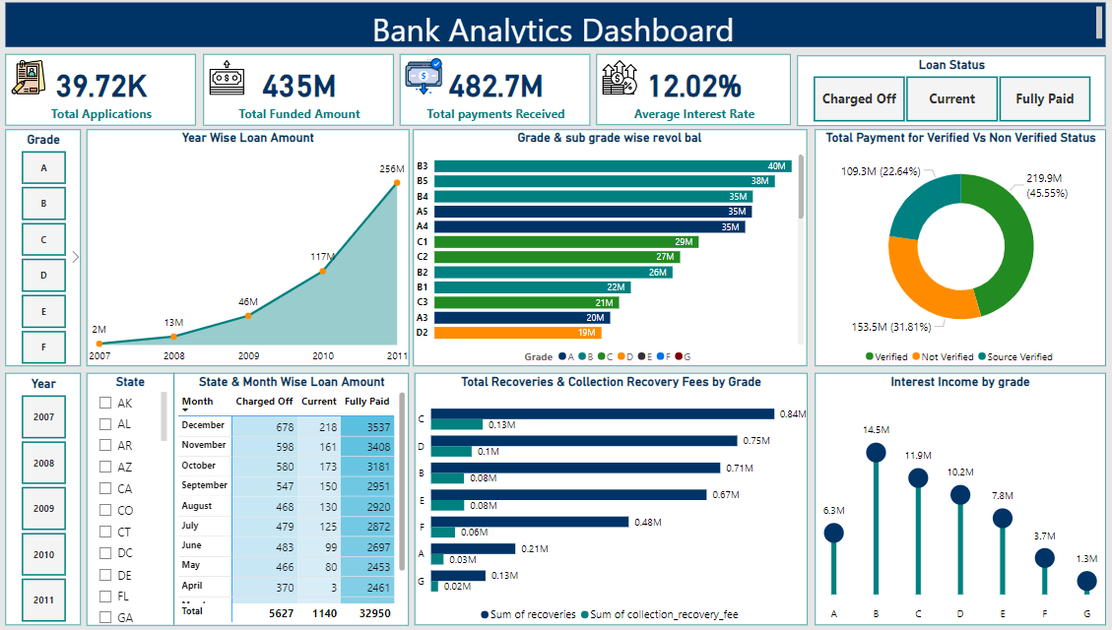
Power BI Dashboard

Slide 10
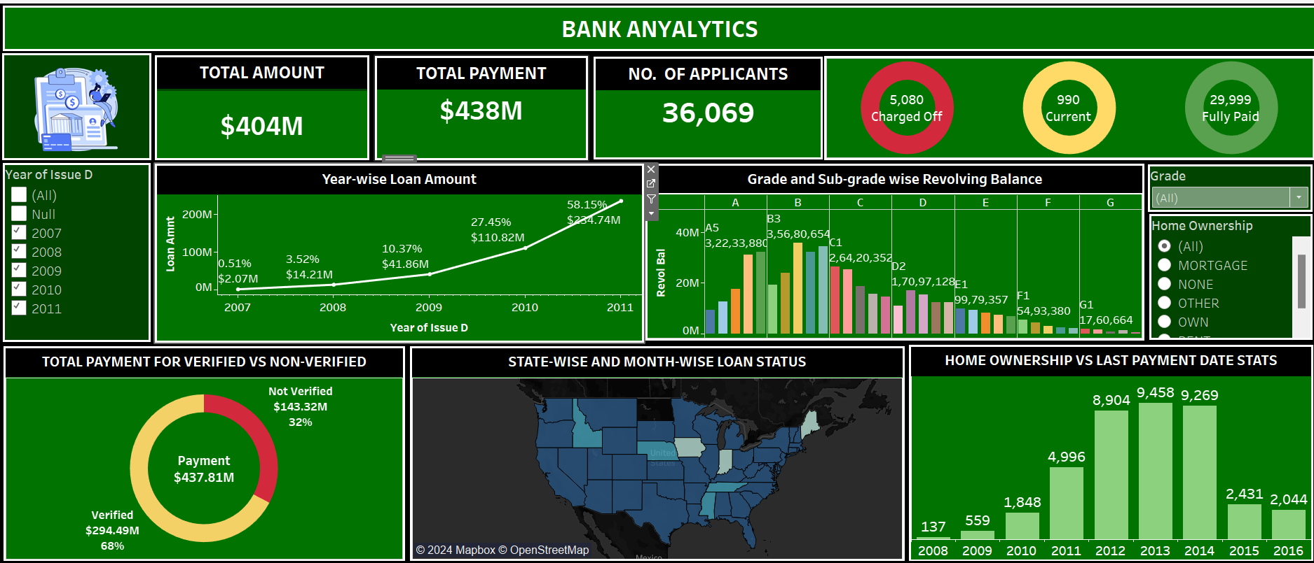
Tableau Dashboard

Slide 11
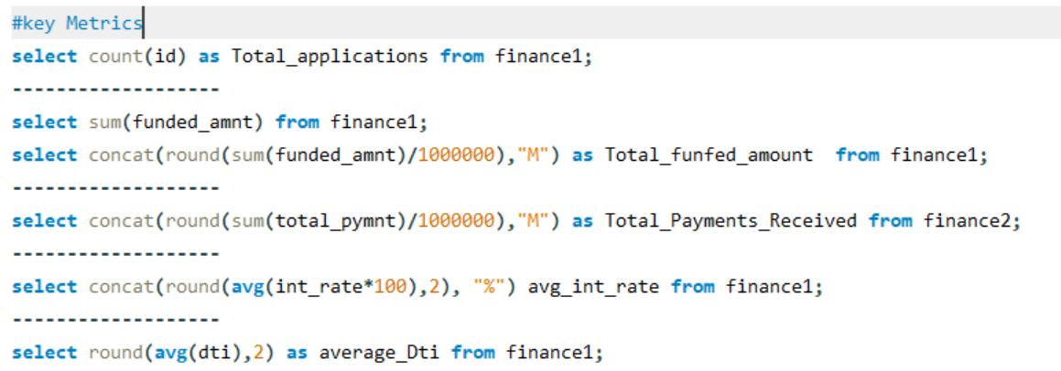
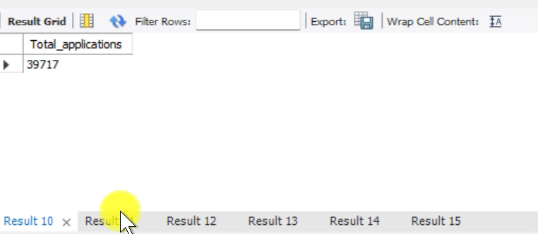
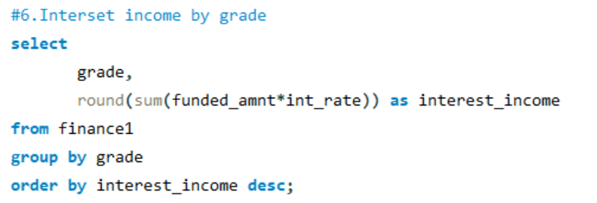
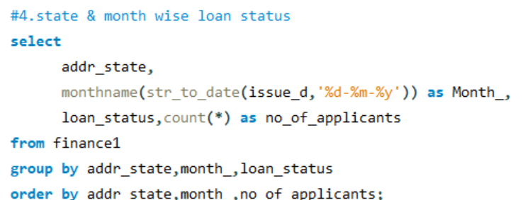
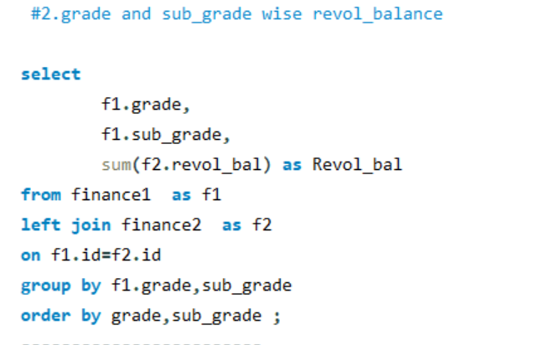
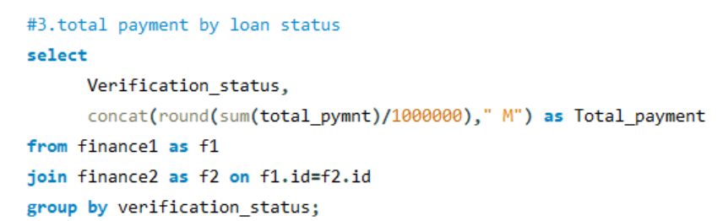
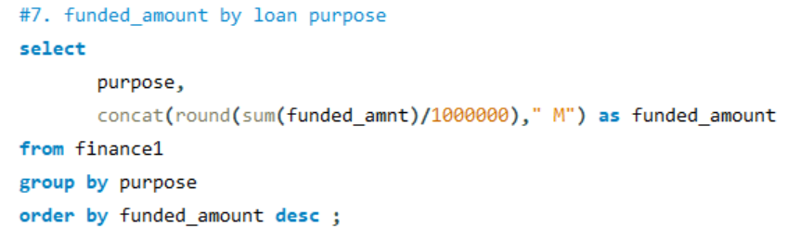
SQL QUERIES

Slide 12
Findings & Insights
No. of Applicants
39717
Total Loan Amount
$445.60M
Total Funded Amount
$434.81M
Total Funded Amount by Investors
$412.96M
Total Recovered Principal Amount
$388.96M
Total Recovered Interest Amount
$89.91M

Slide 13
Insights
This loan portfolio consists of $377.49M in Good debt (86%), representing performing loans, and $68.11M in Bad debt (14%), which includes delinquent or high-risk loans.
The most common reason for borrowing is Debt consolidation.

Slide 14
Insights
The loan portfolio shows $3.78M recovered loans (6% of total loans) to recover this amount bank spent $492.73K to the debt collection agency and $64.33M unrecovered loans (94% of total loans), highlighting the progress in loan repayments and the remaining outstanding balances
The average interest rate varies by grade, with higher-risk grades typically having higher interest rates, providing insight into the risk-return profile across the loan portfolio.

Slide 15
Recommendation for Improvement
Data Quality Assessment:
Why It Matters: Good data is essential for making smart decisions. If the data is incorrect or incomplete, it can lead to mistakes.
What to Do: Regularly check the data for errors, fix any mistakes, and set rules to ensure new data is accurate.
Risk Assessment Models:
Why It Matters: Knowing which loans are likely to default helps the bank avoid financial losses.
What to Do: Analyze past loan data to spot patterns that indicate risk. Use these patterns to create models that predict which borrowers might default.

Slide 16
Recommendation for Improvement
Customer Segmentation:
• Why It Matters: Different customers have different needs. Tailoring products for each group improves satisfaction and loyalty.
• What to Do: Group customers based on factors like age, income, and borrowing history. Then, create targeted marketing strategies for each group.
Loan Performance Tracking:
• Why It Matters: Monitoring how loans are doing helps identify problems early and make necessary adjustments.
• What to Do: Set up dashboards to track key performance metrics, such as repayment rates. Regularly review these metrics to see if any changes are needed.

Slide 17
Thank you!

